Slide 1
Portable Ultrasound Device for Coda-Wave Interferometry Sprint 2
Prepared by Michael Kisellus, Christopher Coppedge, Leyton Foxworthy, Matthew Baker, Kyle Fox
27OCT2023

Slide 2
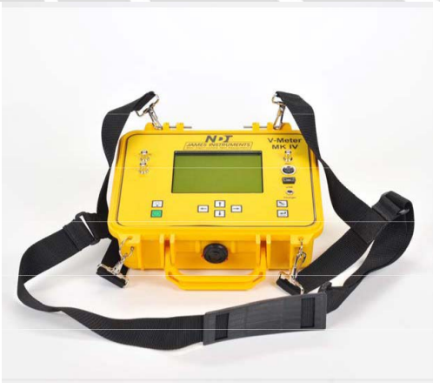
What is this projects goal?
Produce a handheld ultrasound inspection device for inspecting a bridge/structural component for faults in the field.
This handheld unit gathers and stores test data collected over time 72 hours.
Budget - $2000
Existing commercial solution:
Expensive ($5200)
Is not able to record without an operator present

Slide 3
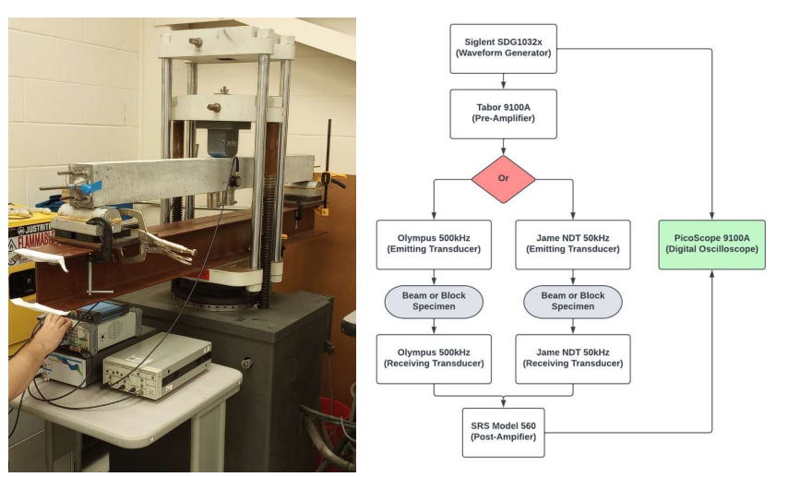
Background:
Civil engineering lab has a concrete “scanning” process that involves measuring how ultrasonic waves travel through the concrete

Slide 4
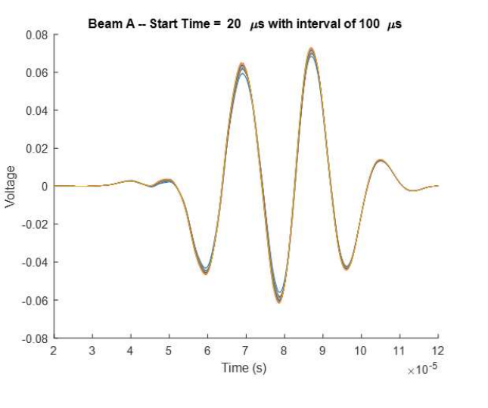
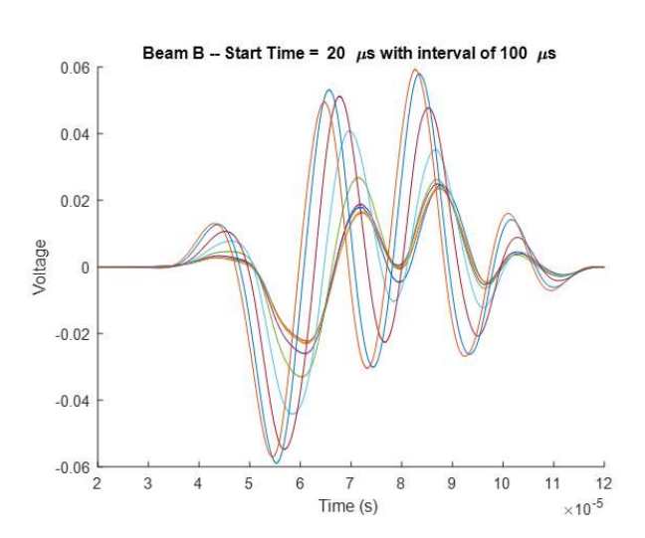
Background:
Data analysis (through MATLAB) is able to reveal imperfections in the concrete.
Scan of a proper piece of concrete
Scan of a compromised piece of concrete

Slide 5
Overview of previous sprint (background)
Coordinating with client to understand scope of project
Division of responsibilities
Preliminary design
Establish budget and parts list
Research parts/ data sheets
SRS, SDS, Test Plan

Slide 6
Progress compared to previous sprint (Work completed)
Electrical system design completed.
Changed: MOSFETS, and added a discharge loop for capacitor.
Cooling system
Software
Clarified data storage strategy
Formatted data collection software correctly
Tx and Rx system
Control system
Enclosure system

Slide 7
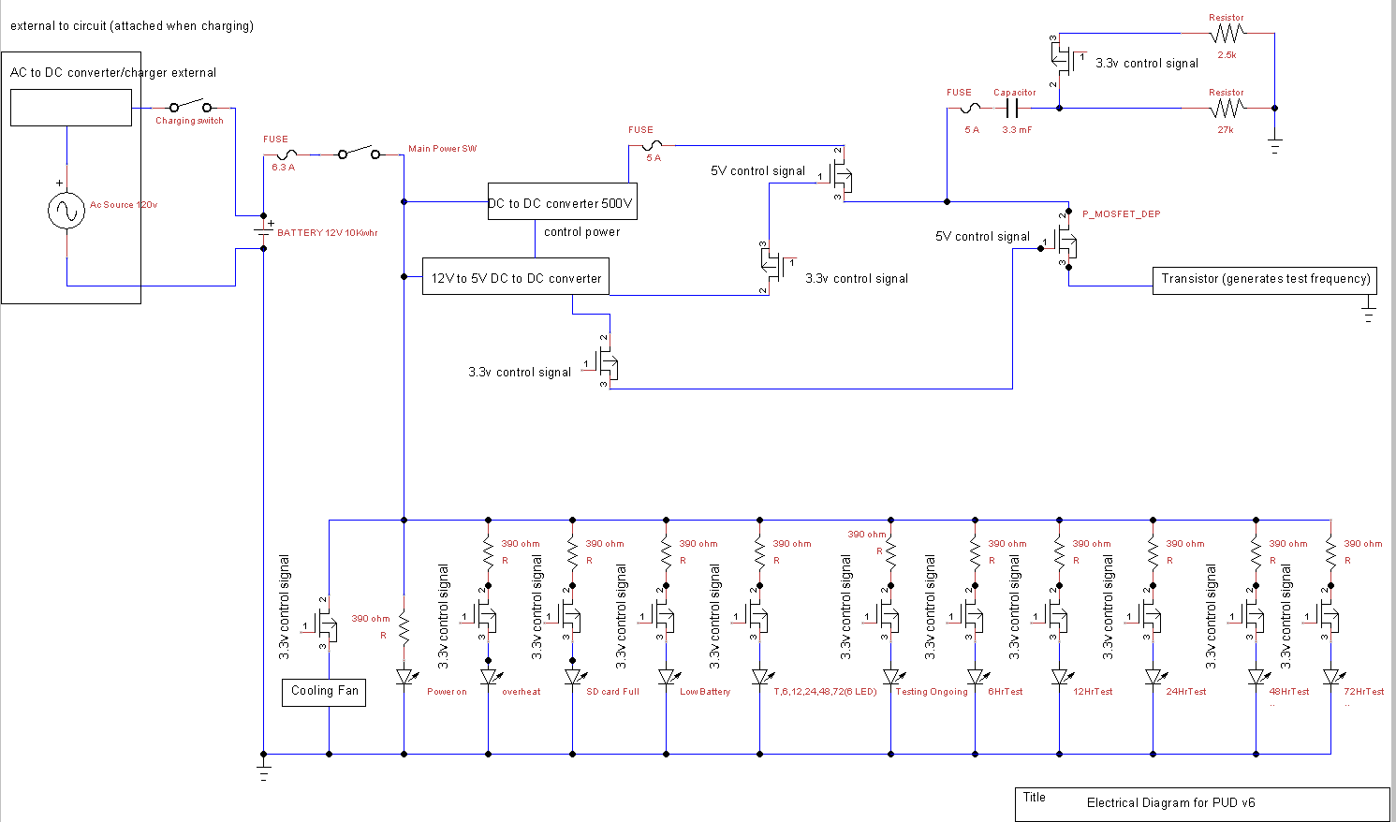

Slide 8
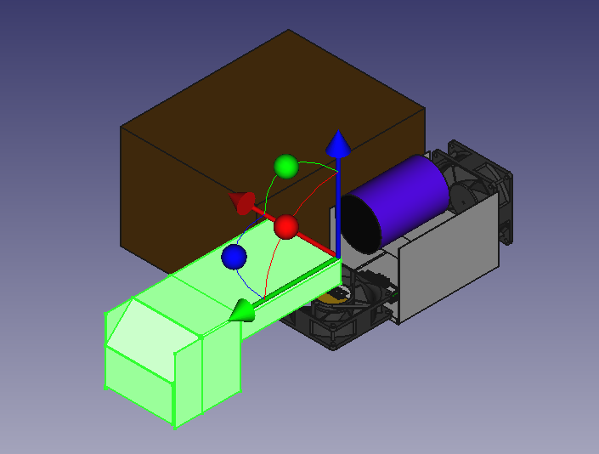
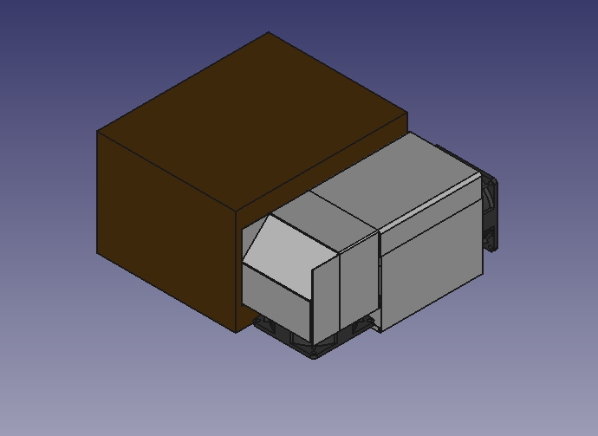
Top Cover Removed to show components
Enclosed Airflow Shroud

Slide 9
Current Status
Electrical system design complete and waiting for parts.
Cooling system
Software
Waiting for parts to begin coding
Tx and Rx system
Control system
Enclosure system

Slide 10
Roles of the Team Members
Michael Kisellus: Electrical system, SDD,SRS
Christopher Coppedge: Enclosure system, parts and acquisition
Leyton Foxworthy: Software
Matthew Baker: Cooling system
Kyle Fox: Tx and Rx system, Control system

Slide 11
Preview of next sprint goals (Work remaining)
Order/ receive parts
Test components individually
Assemble parts into designed system
Program control systems
Test systems per test plan
Troubleshoot as required

Slide 12
Risks or Issues
Part delay of 30 days for 12v to 500v DC to DC converter
High voltage 500V DC present in system. Client requests instructor permission prior to working on the 500 v section.

Slide 13
Parts and Acquisition
Funding for our project has funding that requires purchases be tax exempt. The paperwork has been submitted to all suppliers.
Suppliers
Amazon - Approved our tax exempt status
Digi-Key - Waiting on tax exempt approval
Eco-Worthy - Waiting on tax exempt approval
Mouser - Waiting on tax exempt approval

Slide 14
Visual Demo (video recording, live demo, etc.)
N/A

Slide 15
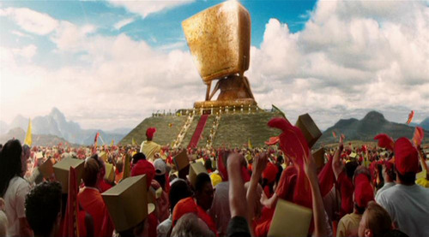

Questions?

